Slide 1


Progress Presentation
Qiuyong Yang, Bei Li, Sheng Wang

Slide 2

Table of Contents
Introduction
Module Structure & File System
Main Program
Clients
Installer

Slide 3
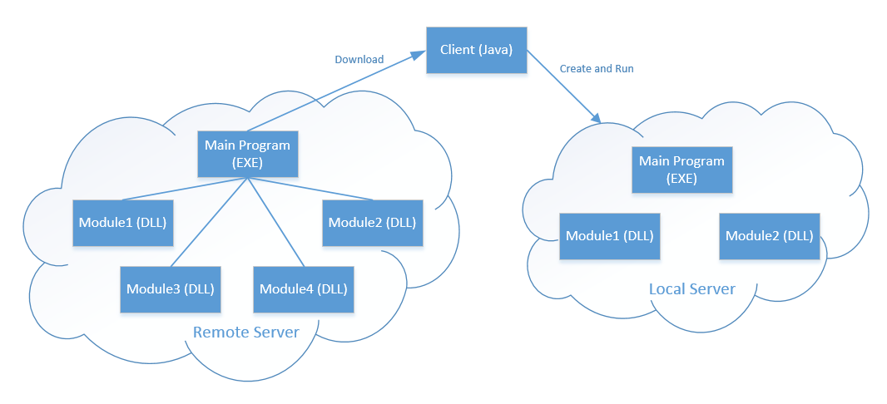
Introduction
It was:

Slide 4
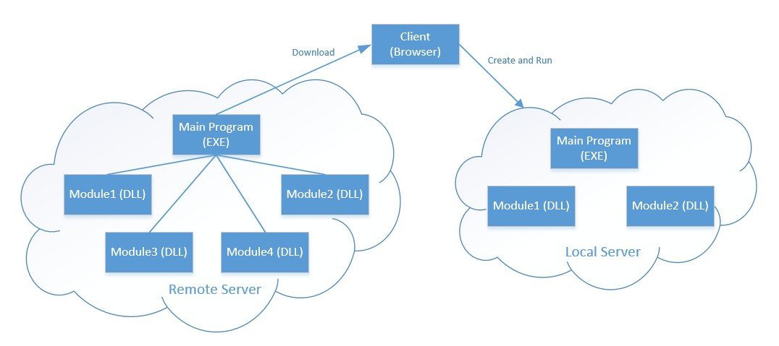
Introduction
It is:

Slide 5
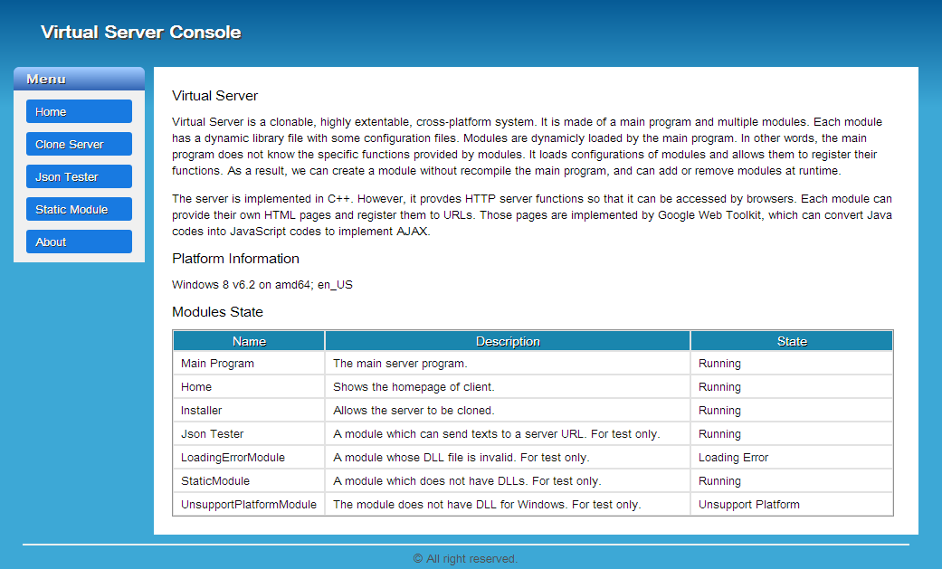
Introduction

Slide 6
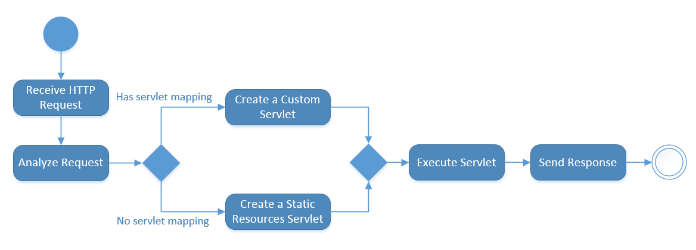
Introduction
Handle a single HTTP request:

Slide 7
XML Files
File System
Module Structure

Slide 8
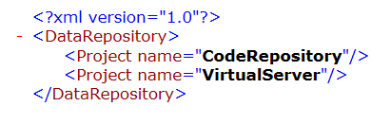

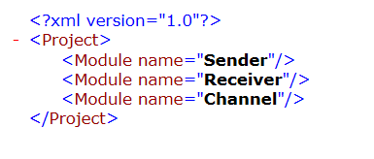
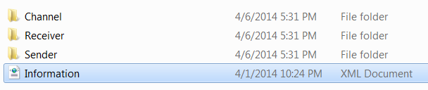
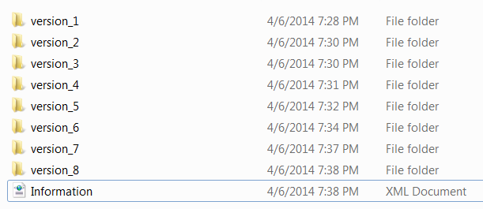
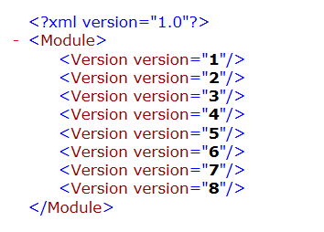
File System

Slide 9
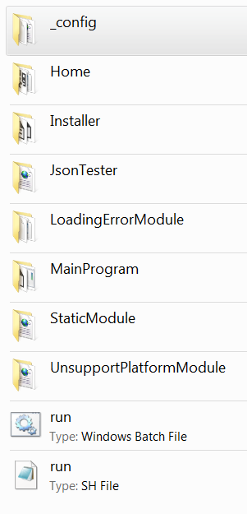
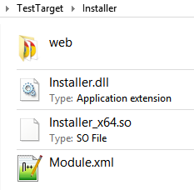
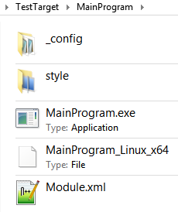
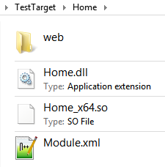
Module Structure

Slide 10
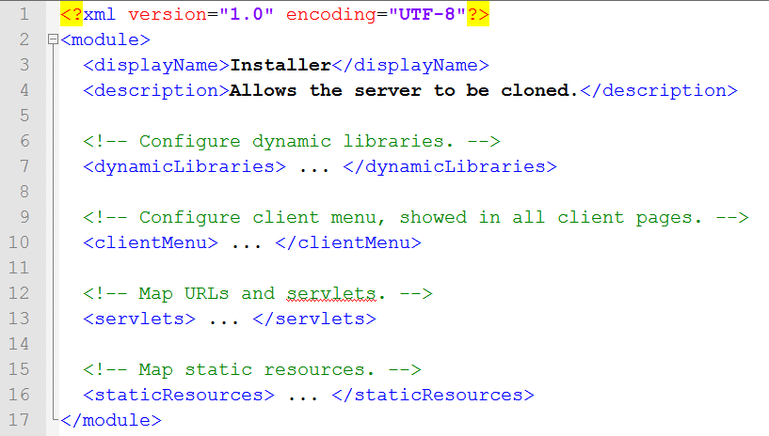
Module Structure
Module.xml (Demo)

Slide 11
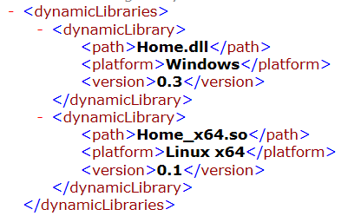
Module Structure
Dynamic Libraries:

Slide 12
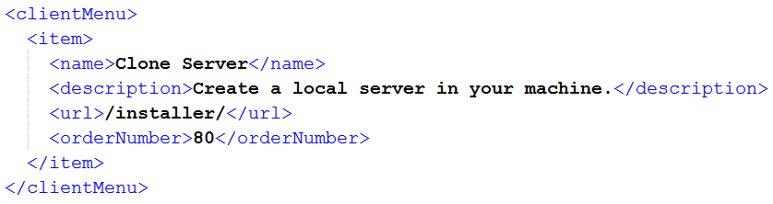
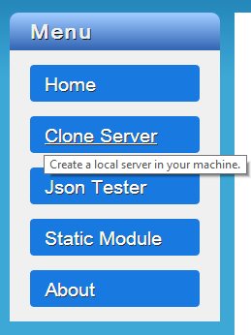
Module Structure
Client Menu:

Slide 13
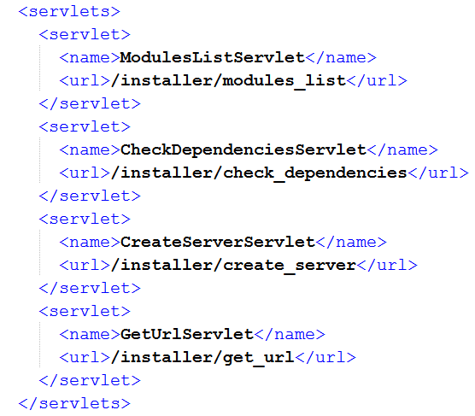
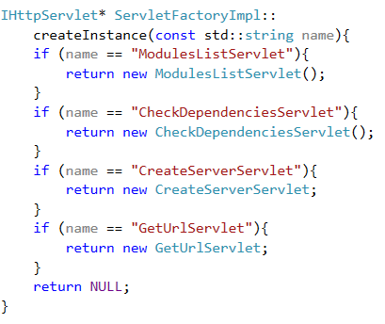
Servlet Mapping
URL
Servlet Pointer
Servlet Name

Slide 14
Servlet Mapping

Slide 15
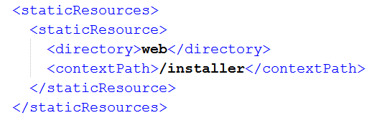
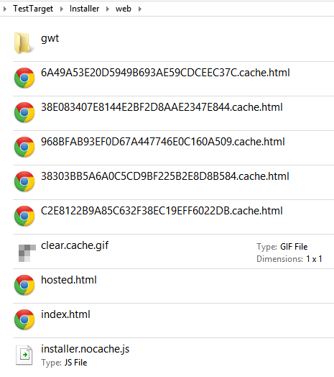
Module Structure
Static Resources Mapping:
For example:
/installer/index.html
-> Installer\web\index.html
/installer/installer.nocache.js
-> Installer\web\installer.nocache.js

Slide 16
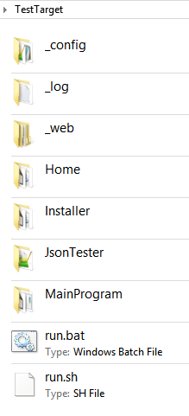
Main Program
How to load modules:
Iterate sub directories in the current working directory.
For each subdirectory:
  Check whether the subdir contains Module.xml.
  Analyze the Module.xml.
  Load dynamic library if possible.

Slide 17
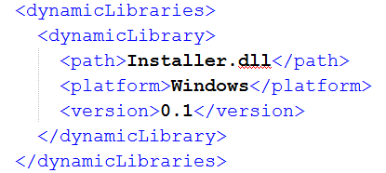
Main Program
Special Cases of Modules: (Demo)
No any library config:
  static module
No such platform:
  unsupported platform
Has such platform but no library file:
  unsupported platform

Slide 18
Main Program
Demo: loading modules
  remove a module directory
  remove a module library
  put them back

Slide 19
Main Program
How to connect Main Program and modules:
Main Program:
  provides MainObjectFactory
  calls "loadModule()"
Module:
  provides ModuleObjectFactory
  implements "loadModule()"
"loadModule()" in module's libraries:
  parameter: MainObjectFactory
  return value: ModuleObjectFactory

Slide 20
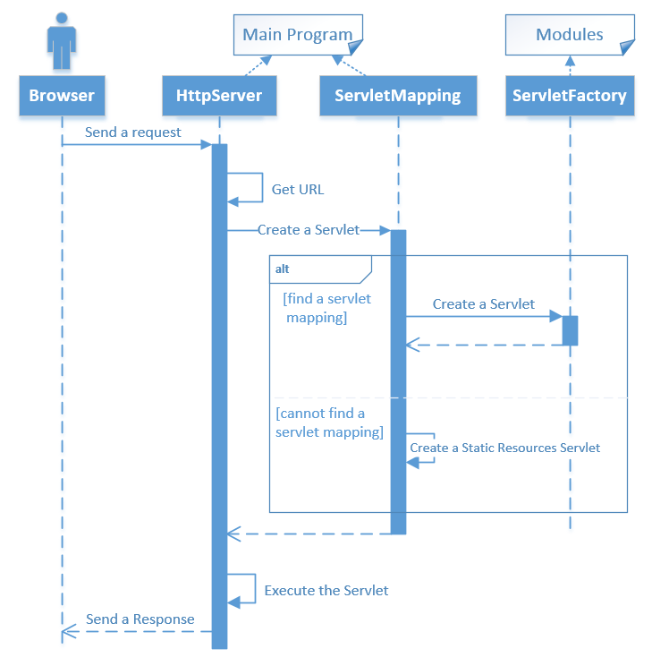

Slide 21
Main Program
HTTP server in Main Program:
  implemented by ourselves
  multiple threads
  provides a std::istream to read request
  provides a std::ostream to write response
  supports "keep-alive"
  can cache response body and add "Content-Length" automatically

Slide 22
Clients
Structure
  All files are static files (html, js and images)
  AJAX for communications (JSON)
  Files are provided by modules, separately.
Advantage
  Client development and server development can be separated.
  Avoid generating HTML in C++ codes
  JSON can be parsed in server easily

Slide 23
Clients
Google Web Toolkit
  an AJAX framework
  converts Java code to JavaScript
  high compatibility for popular browsers
  provides optimized JavaScript, CSS and images

Slide 24
Clients
Demo: client features
  pages are separated in modules
  source codes of HTML pages
  history control of AJAX

Slide 25
Installer Module
How to clone a server: (Demo)
  clone a server from Windows to Linux
  choose modules and platforms
  download and run
  change configurations

Slide 26
Installer Module
What did it do?
  copy module's directories
  exclude unselected libraries
  ZIP them to a file

Slide 27
Summary
Visual Studio Online
  team work
Future Work
  module dependencies
  file repository
  upload modules

Slide 28
Thanks

